Slide 1
CyFun toolbox en safeonweb@work voor kmo’s
TLP:GREEN
Karl Dobbelaere

Slide 2
Safeonweb@work

Slide 3
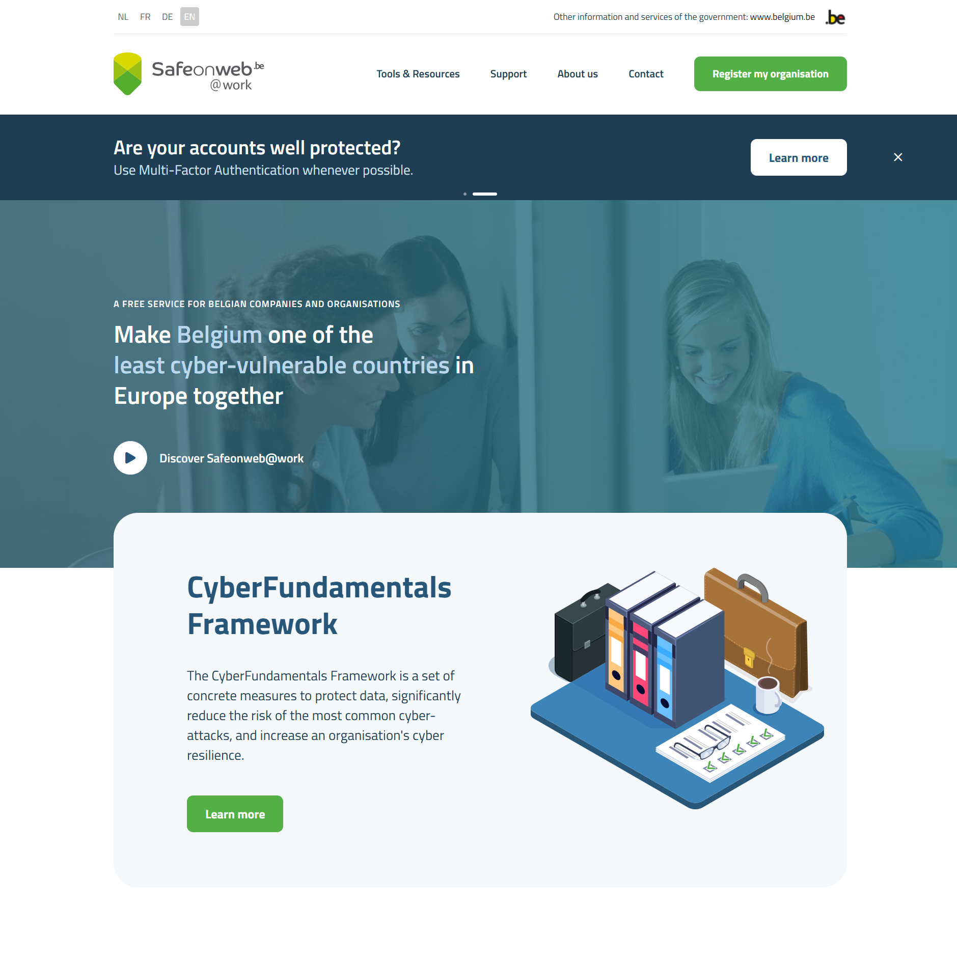
Safeonweb@work
https://atwork.safeonweb.be/
Safeonweb@work is an initiative of the Cybersecurity Centre Belgium (CCB) aimed at Belgian companies and organisations.
Its aim is to strengthen the cybersecurity of Belgian companies and organisations by providing them with advice, recommendations and tools via various services, enabling them to identify and mitigate the vulnerabilities of their systems and to be alerted to cyberthreats.

Slide 4
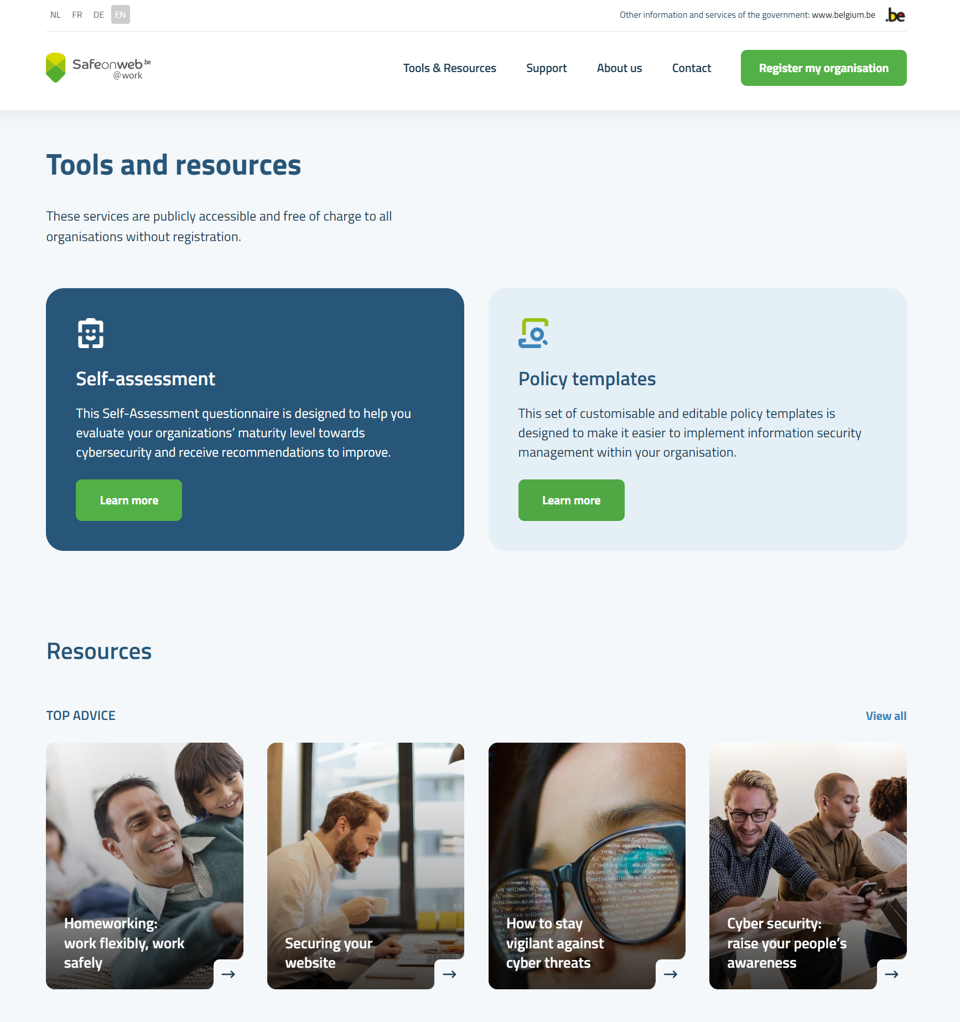
Tools and Resources
Cybersecurity reference materials
CyberFundamentals framework
Self-Assessment
Policy templates
News, Guidelines and Reports
Articles – Top Advice and Common Threats
Videos and Webinars
Quick Wins, list of subsidies and other initiatives in Belgium

Slide 5
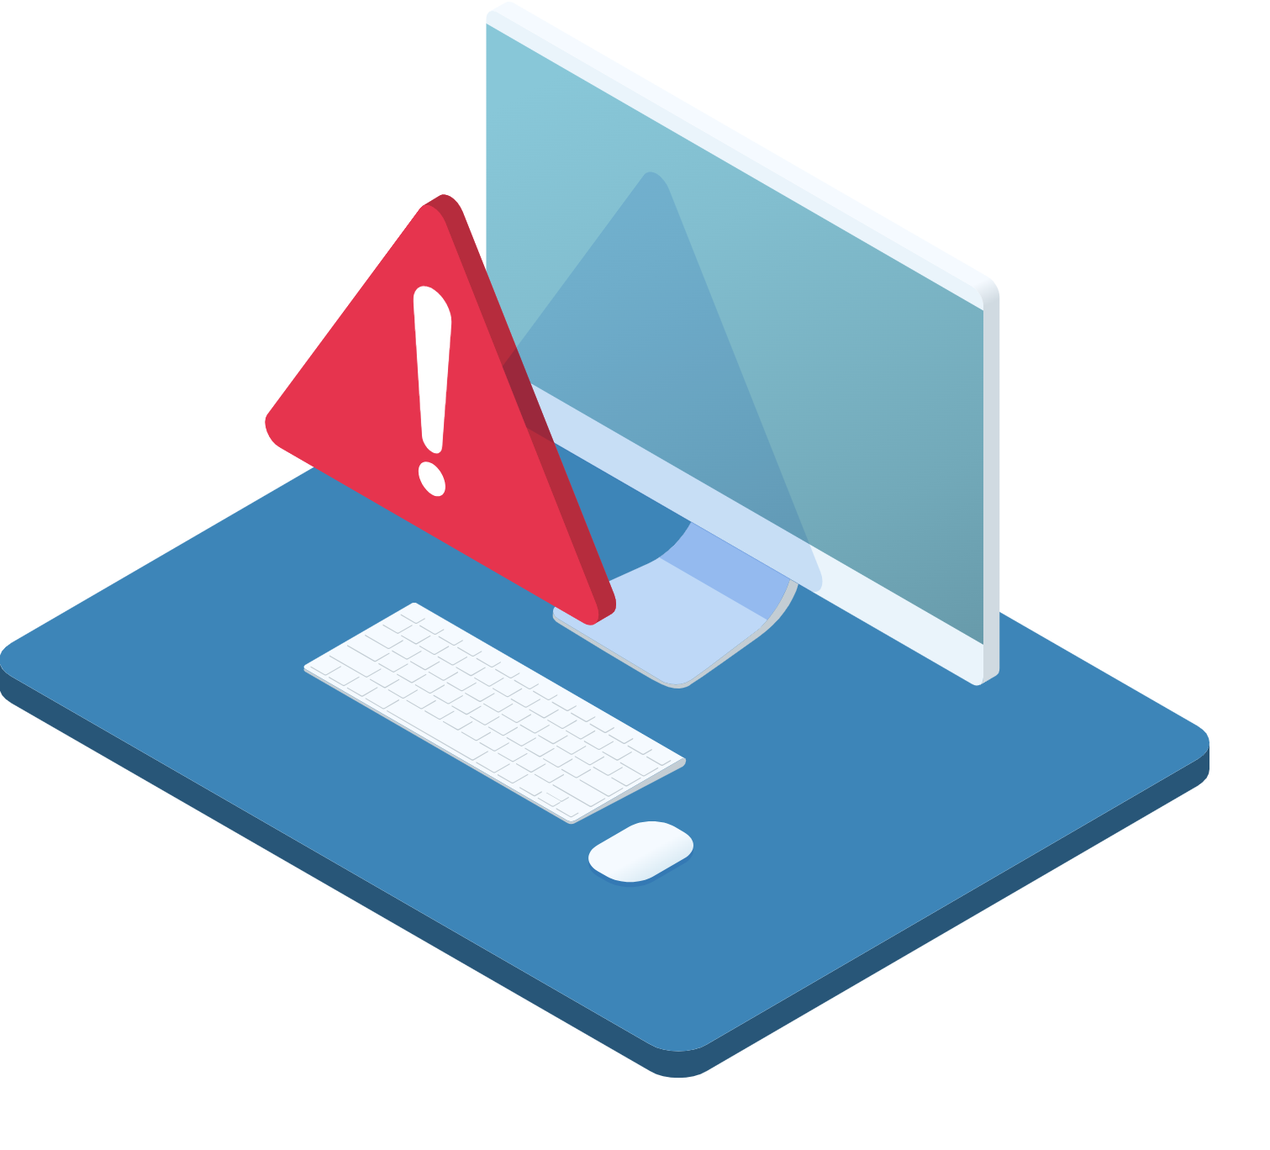
Cyber Threat Alerts
The Cyber Threat Alerts service helps your organisation to investigate and mitigate potential cyber threats on your network by being notified of vulnerabilities and infections.
Stay alerted of threats and vulnerabilities ;
Improve your organisation's protection ;
Gain Trust in the security of your network ;
Accessible to all companies and organisations in Belgium ;

Slide 6

Quick Scan Report
The Quick Scan Report service allows you to receive a report that will give you an overview of security vulnerabilities and improvement opportunities for your online assets.
Get an instant overview of your organisation cybersecurity posture.
Report documents include a quick overview of your situation that can easily be shared with your management and stakeholders as well as documentation detailing each risk to facilitate their mitigation.
Reports include concrete and practical recommendations to address identified risks.
Reports include comprehensive categories, ratings and a color code easily understood by non-technical stakeholders and senior management.

Slide 7
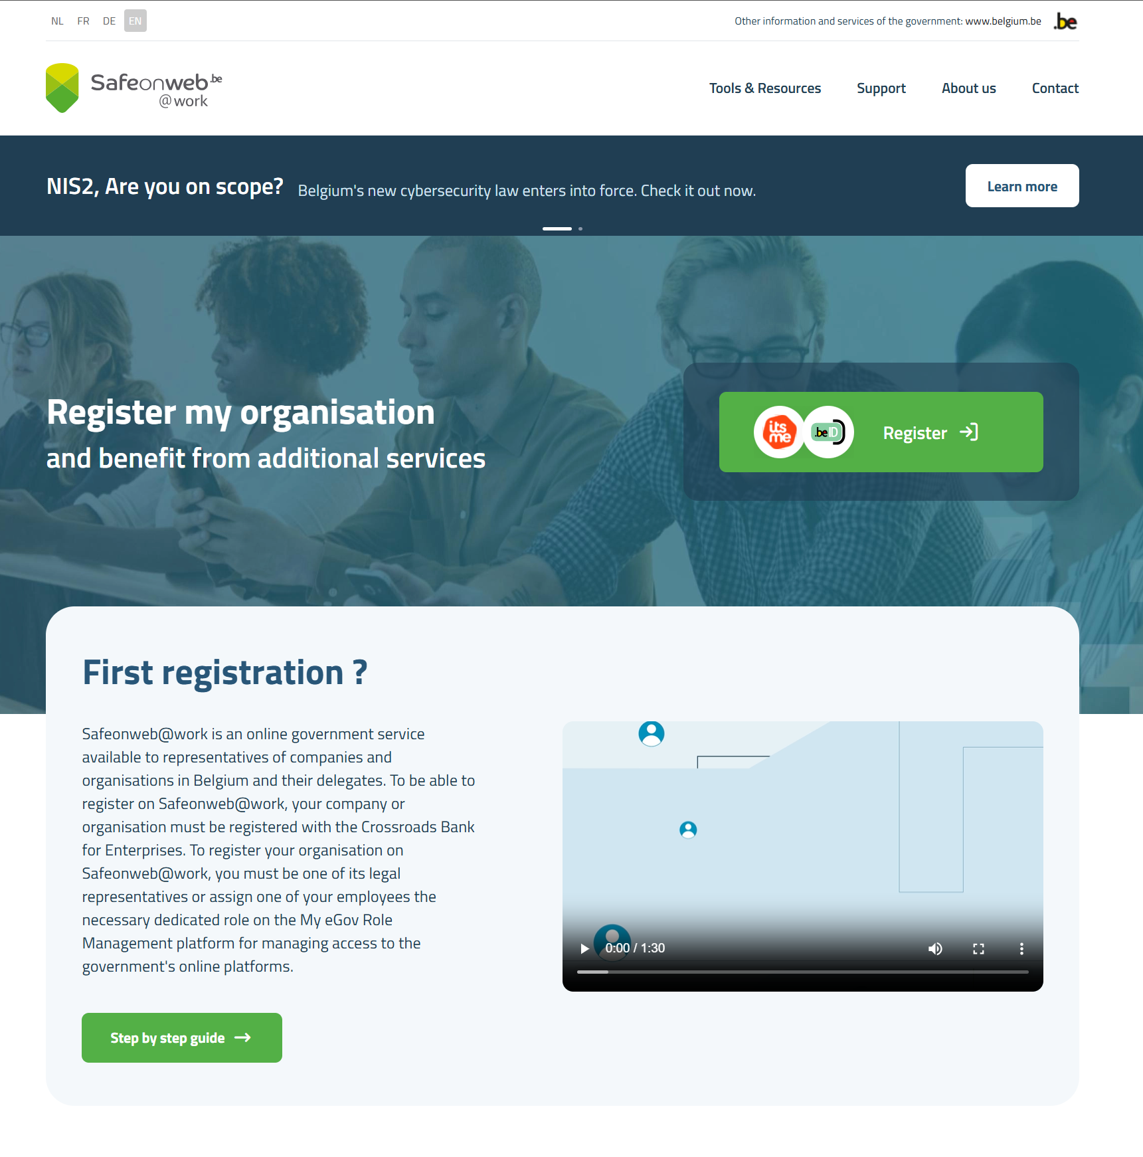
Register your organisation
And benefit from additional services
Get alerted from potential threats and vulnerabilities on your network.
Detect, assess and mitigate vulnerabilities on your domain.
Increase user trust in your website.
Improve your organisation’s protection and gain confidence in the security of your network.

Slide 8
CyFun Toolbox

Slide 9
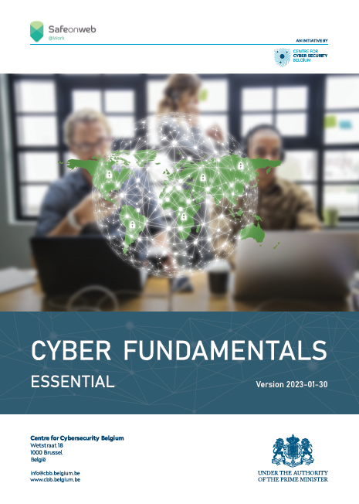
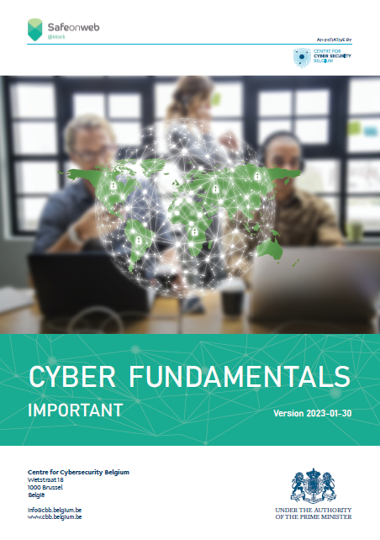
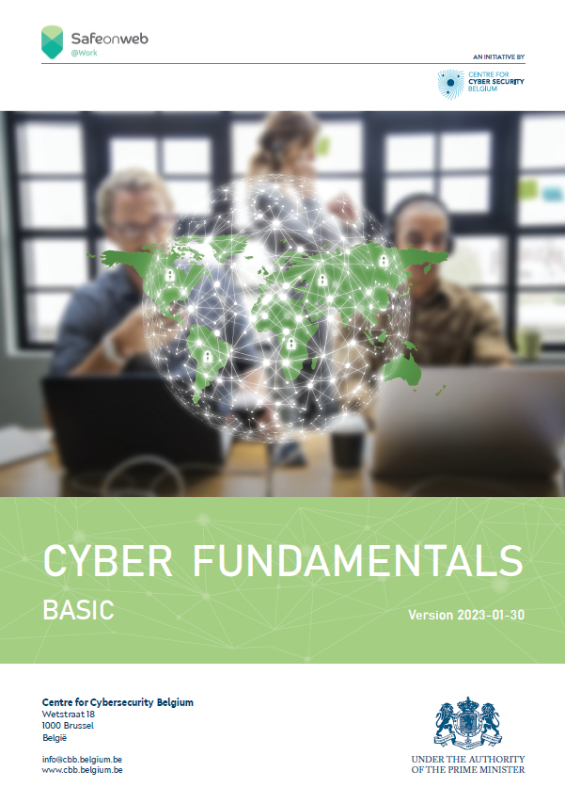
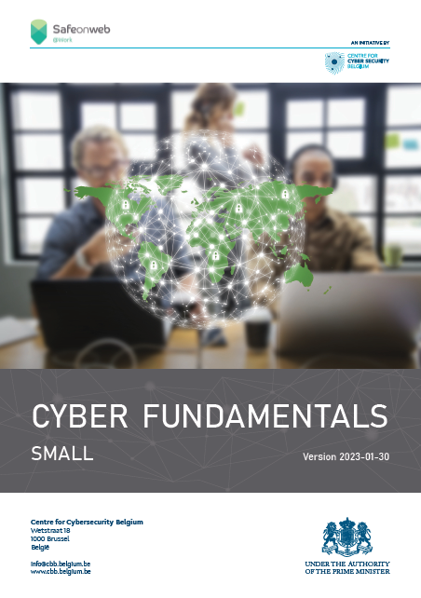
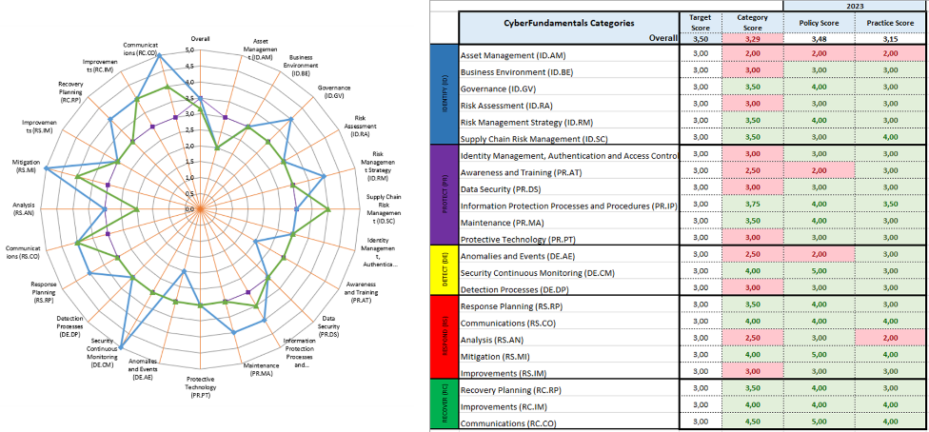
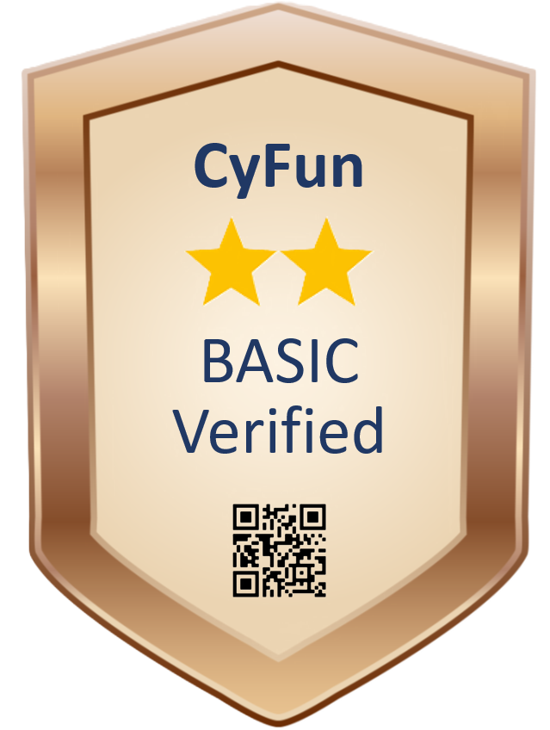
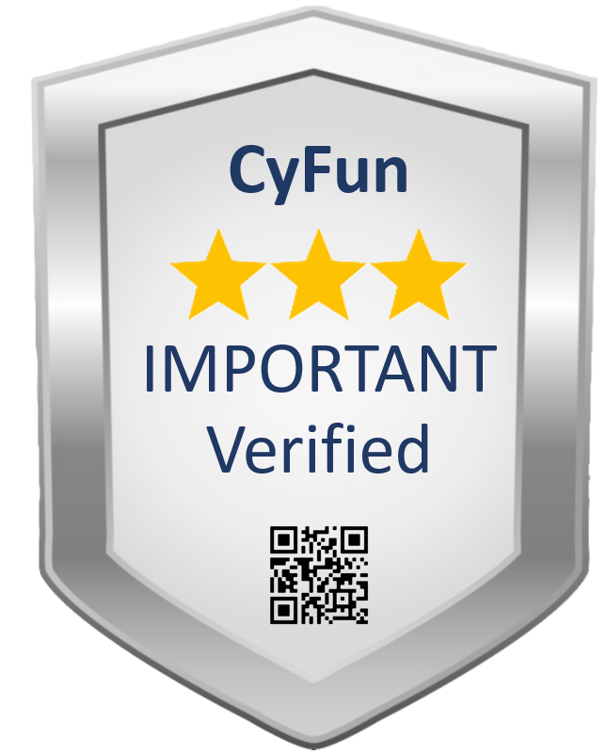
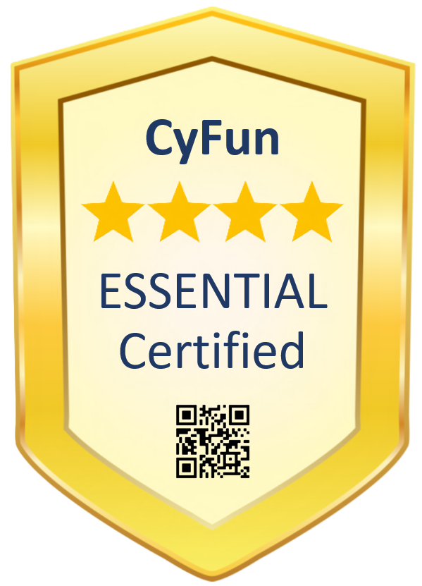
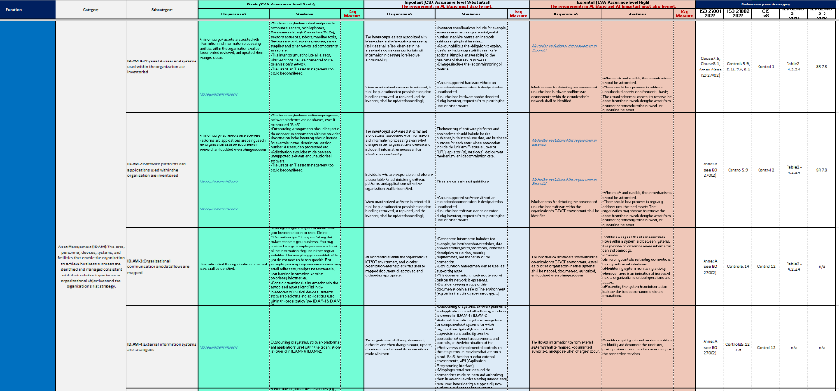
Additional info - CyberFundamentals toolbox
CyFun Selection tool
(Risk Assessment)
CyFun Self-Assessment tool
CyberFundamentals
Conformity Assessment
Scheme for CAB’s
CyberFundamentals
Framework mapping
CyberFundamentals Toolbox is publicly available ➔ www.cyfun.eu

